Slide 1
Capacity Building for Survivor Leaders of Trafficking in Human Beings
E-LEARNING COURSE LAUNCH
Heather Wokusch, M.A. April 2023

Slide 2
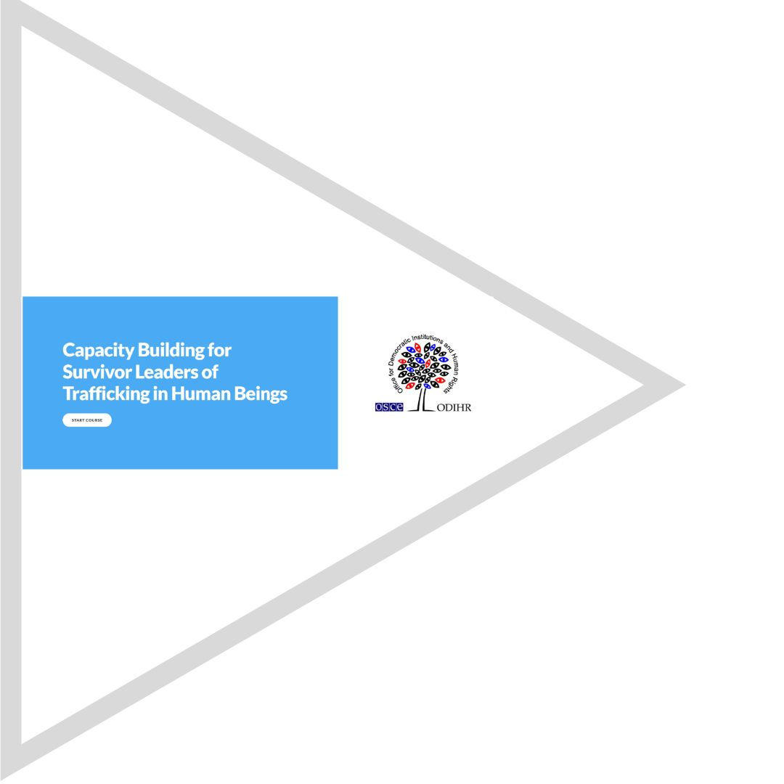
Overview
Our agenda
01
Virtual Learning
02
Project Specs
03
Module Showcase
04
Possible Extensions
Heather Wokusch, M.A.
2

Slide 3
Virtual Learning Benefits
01
03
Promotes scaling
Flexible and inclusive
02
04
Reduces costs
Measurable results
Heather Wokusch, M.A.
3

Slide 4
Bad Old Days
Information push
Heather Wokusch, M.A.
4

Slide 5
Today’s Approach
RELEVANT
MODULAR
SCALABLE
INTERACTIVE
Heather Wokusch, M.A.
5

Slide 6
Starting Point
‘Capacity Building for Survivor Leaders of Trafficking in Human Beings’
Strong base
Modular approach
.
Clear aims
Passion to succeed
Heather Wokusch, M.A.
6

Slide 7
A Tour of the Modules
Heather Wokusch, M.A.
7

Slide 8
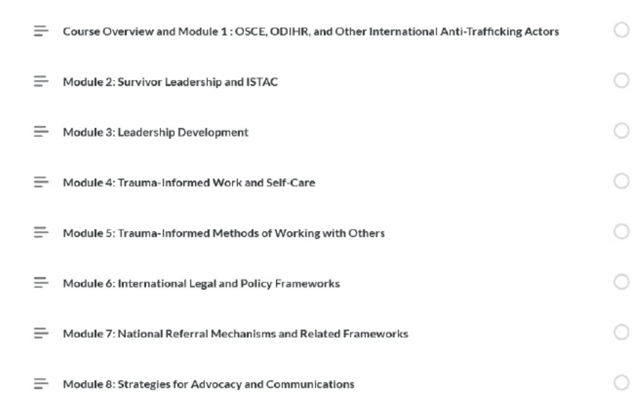
A Tour of the Modules
Heather Wokusch, M.A.
8

Slide 9
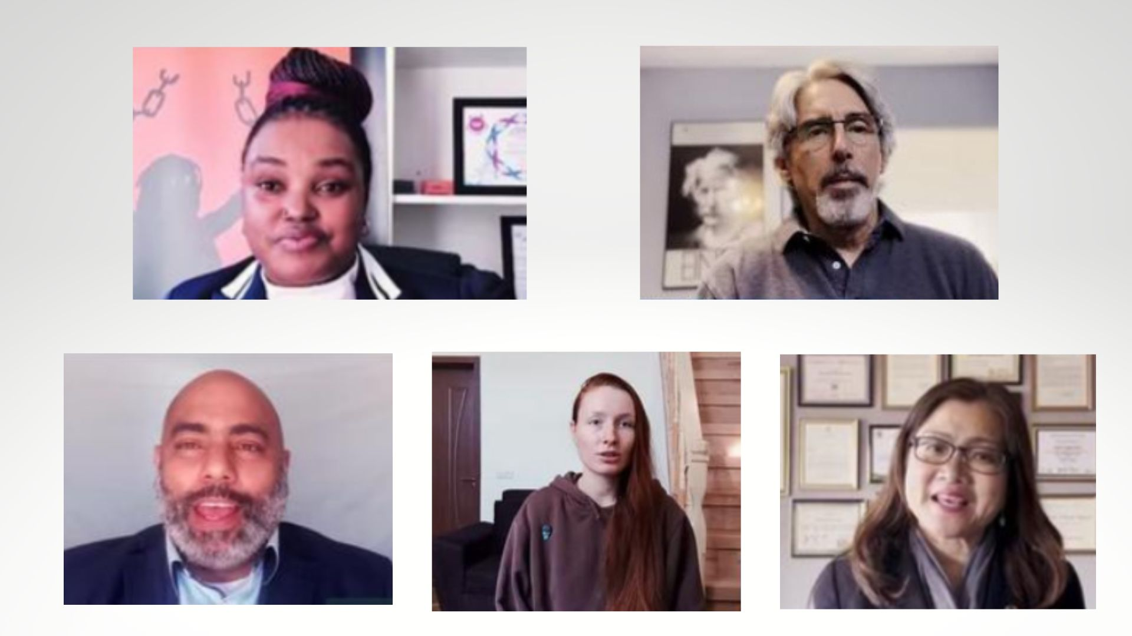
A Tour of the Modules
Heather Wokusch, M.A.
9

Slide 10
Adaptability and Scalability
Base Modules
Languages
Extensions
Heather Wokusch, M.A.
10

Slide 11
Sectors and Industries
Targeted modules created with the input of people with corresponding lived experience. Some examples:
Transport
Healthcare
Hotel
Education
Heather Wokusch, M.A.
11

Slide 12
Target groups
Targeted modules created with the input of people with corresponding lived experience. Some examples:
BORDER GUARDS
TIMELY
CASES
CHILDREN
LEGAL REPS
Heather Wokusch, M.A.
12

Slide 13
Heather Wokusch, M.A.
heather@heatherwokusch.com
Thank you!
Heather Wokusch, M.A.
13

